Slide 1
Implement Spanning Tree Protocols
LAN Switching and Wireless – Chapter 5

Slide 2
Objectives
Explain the role of redundancy in a converged network
Summarize how STP works to eliminate Layer 2 loops in a converged network
Explain how the STP algorithm uses three steps to converge on a loop-free topology
Implement rapid per VLAN spanning tree (rapid PVST+) in a LAN to prevent loops between redundant switches.

Slide 3
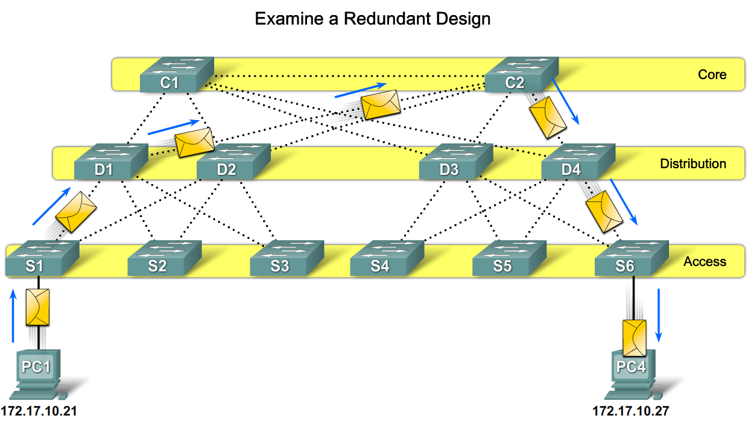
Explain the Role of Redundancy in a Converged Switched Network
Describe the role redundancy in a hierarchical network

Slide 4
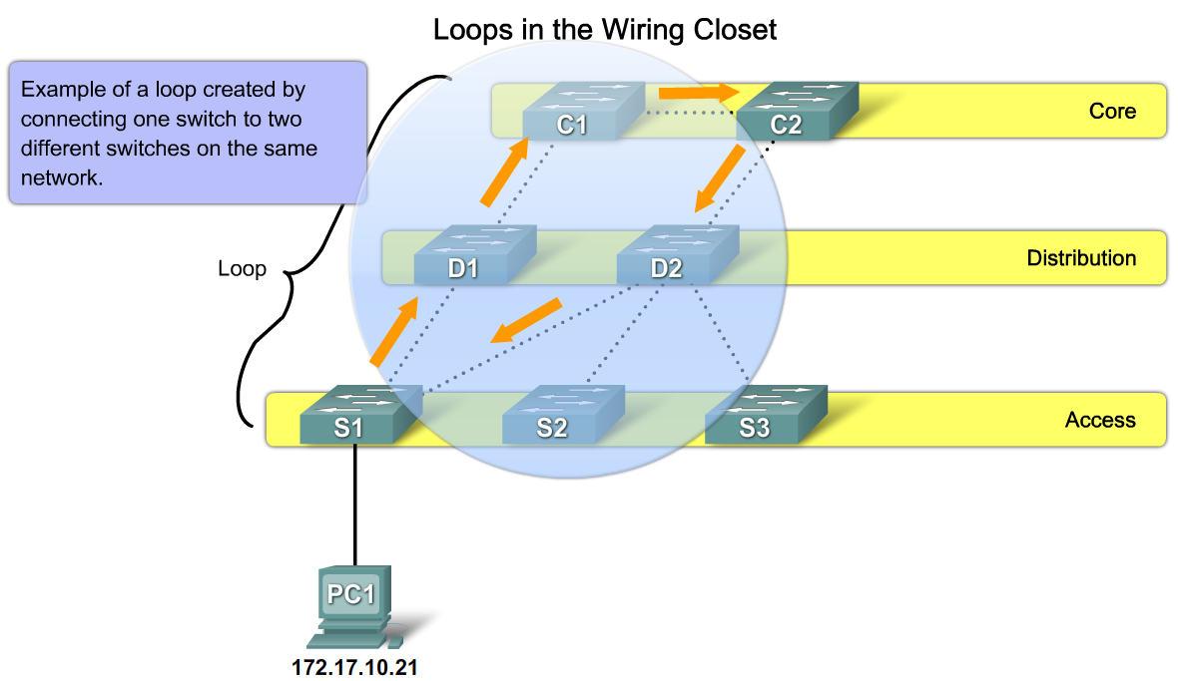
Explain the Role of Redundancy in a Converged Switched Network
Describe how redundancy can disable a hierarchical network

Slide 5
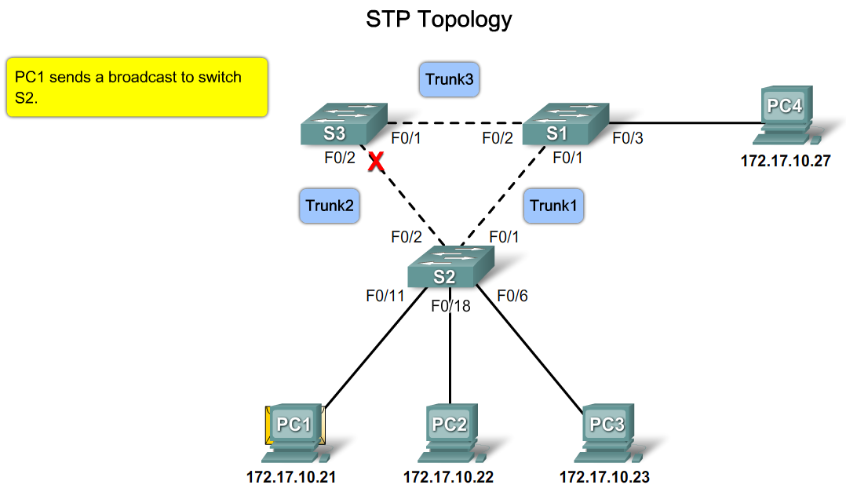
Explain the Role of Redundancy in a Converged Switched Network
Explain how Layer 2 loops occur in well managed networks

Slide 6
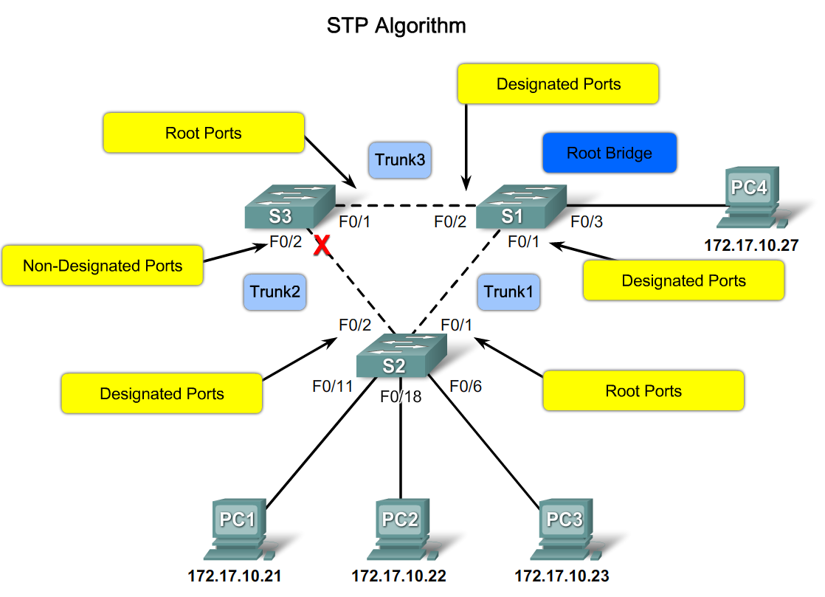
Summarize How STP works to Eliminate Layer 2 Loops in a Converged Network
Describe the STP algorithm

Slide 7
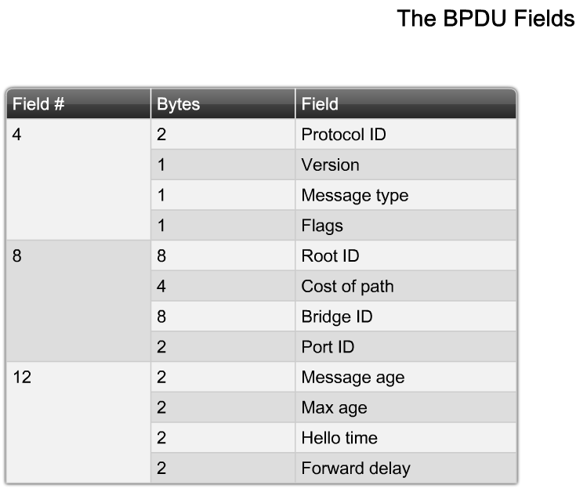
Summarize How STP works to Eliminate Layer 2 Loops in a Converged Network
Explain the role of the BPDU in STP

Slide 8
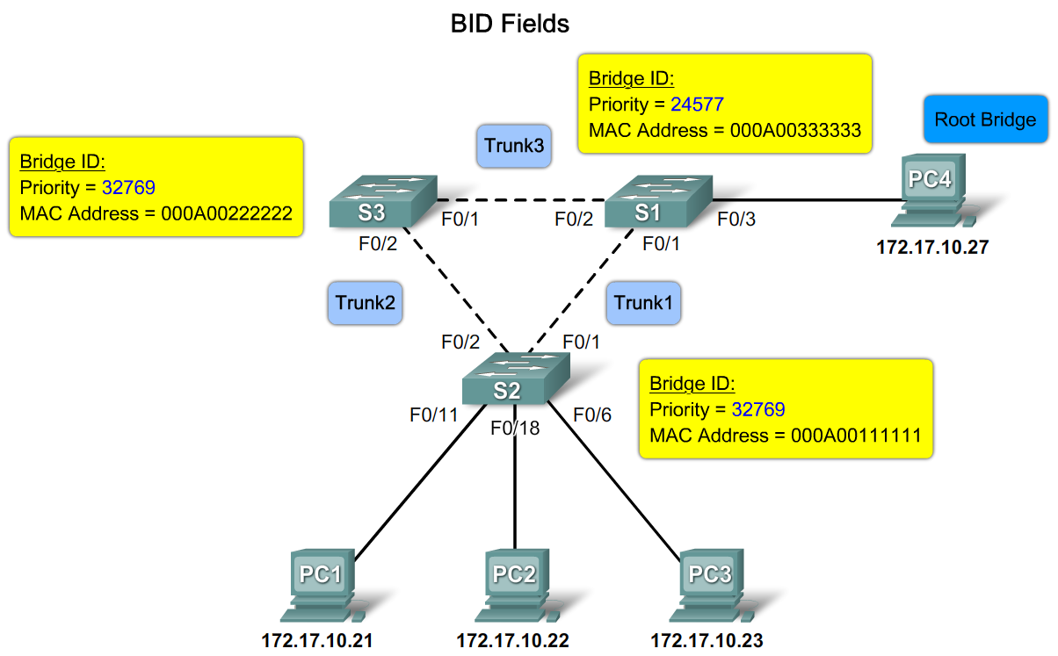
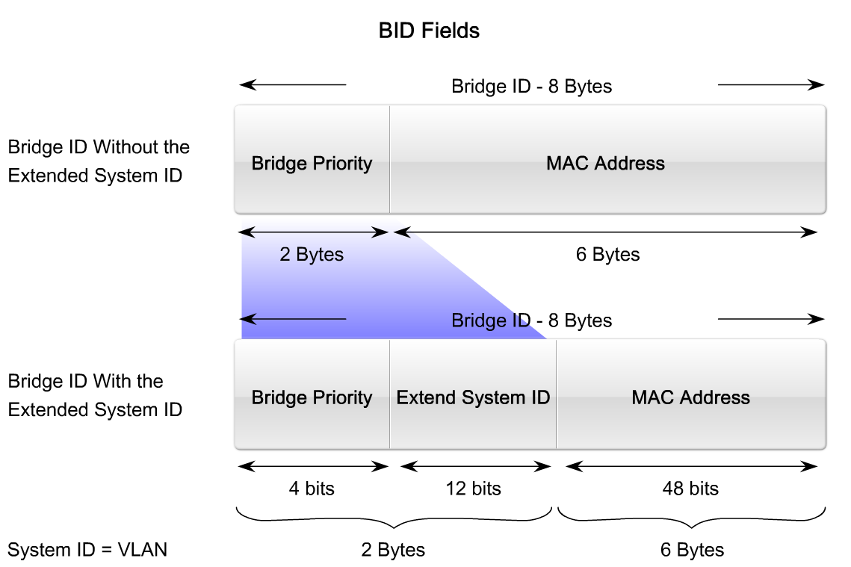
Summarize How STP works to Eliminate Layer 2 Loops in a Converged Network
Explain the role of the BID in STP

Slide 9
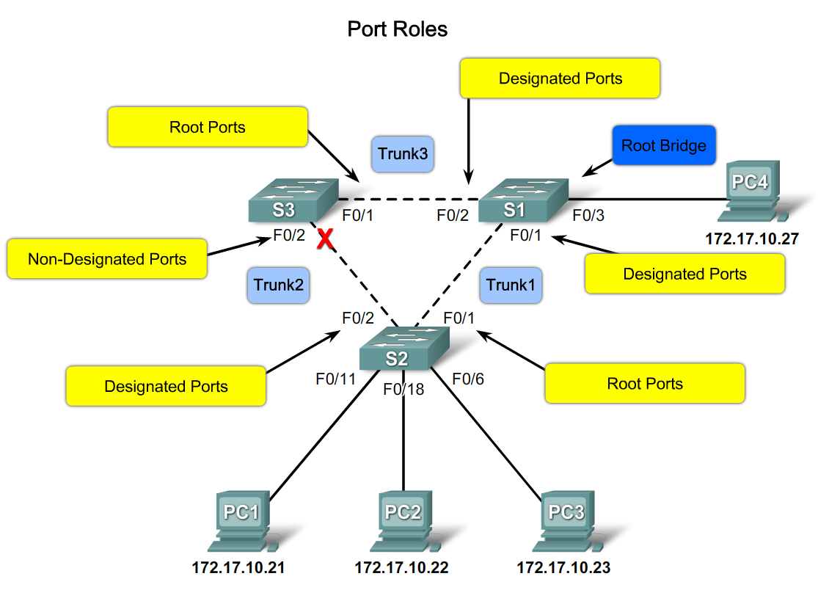
Summarize How STP works to Eliminate Layer 2 Loops in a Converged Network
Describe the how port roles support the operation of STP

Slide 10
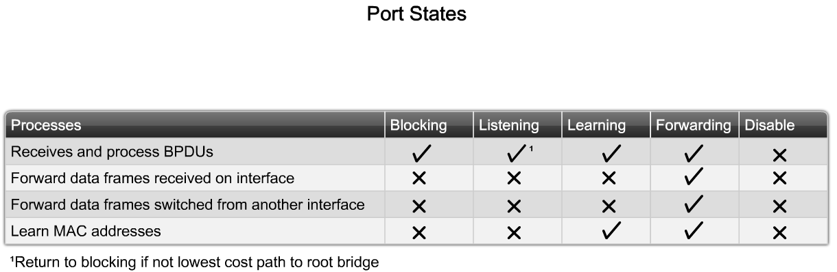
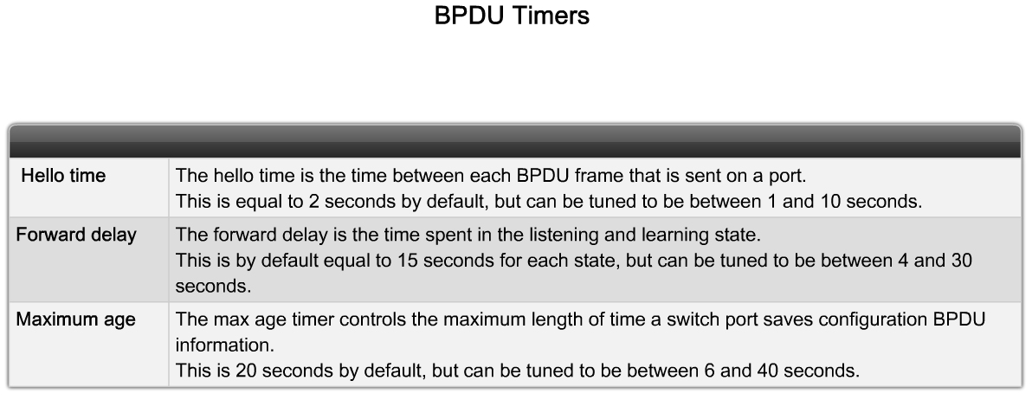
Summarize How STP works to Eliminate Layer 2 Loops in a Converged Network
Describe the role of STP port states and BPDU timers in the operation of STP

Slide 11
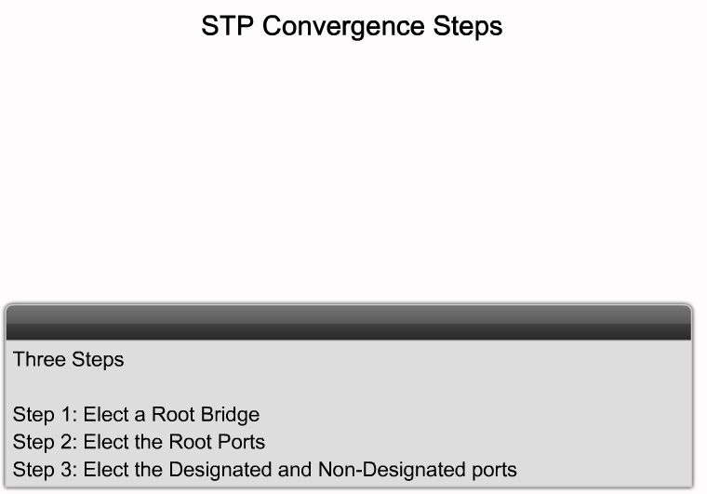
Explain How the STP Algorithm Uses Three Steps to Converge on a Loop-Free Topology
Define convergence for a switched network and summarize the 3 step process STP uses to create a loop free topology

Slide 12
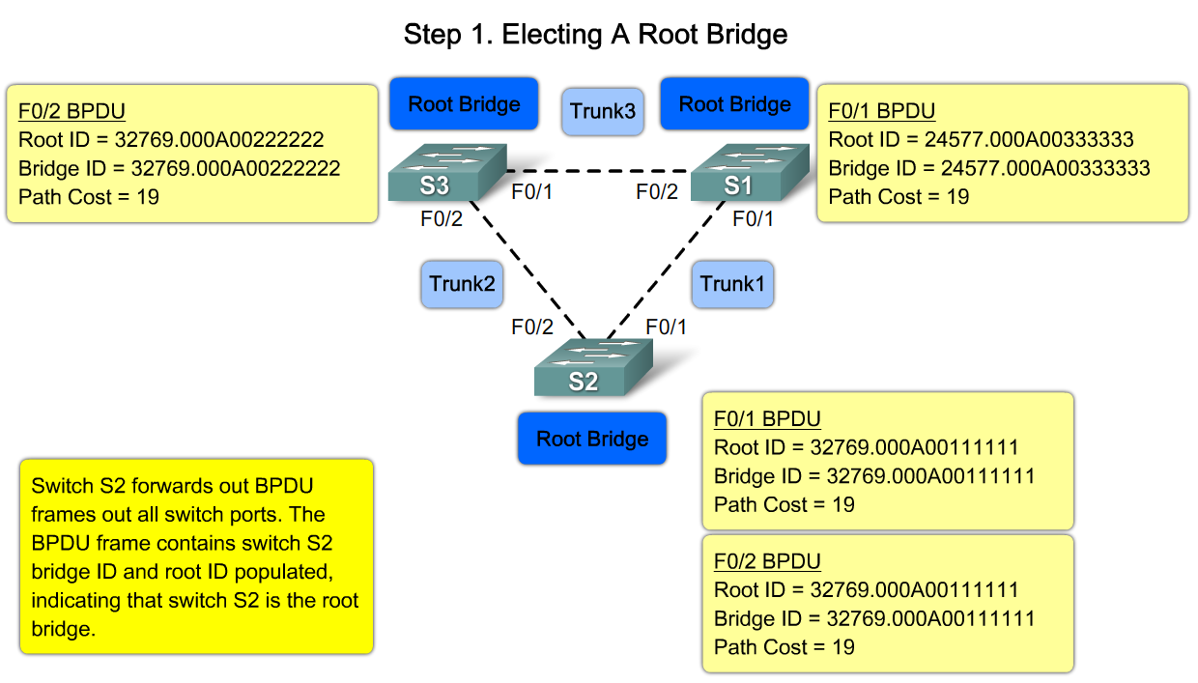
Explain How the STP Algorithm Uses Three Steps to Converge on a Loop-Free Topology
Explain the STP decision sequence is used to elect a root bridge for a network

Slide 13
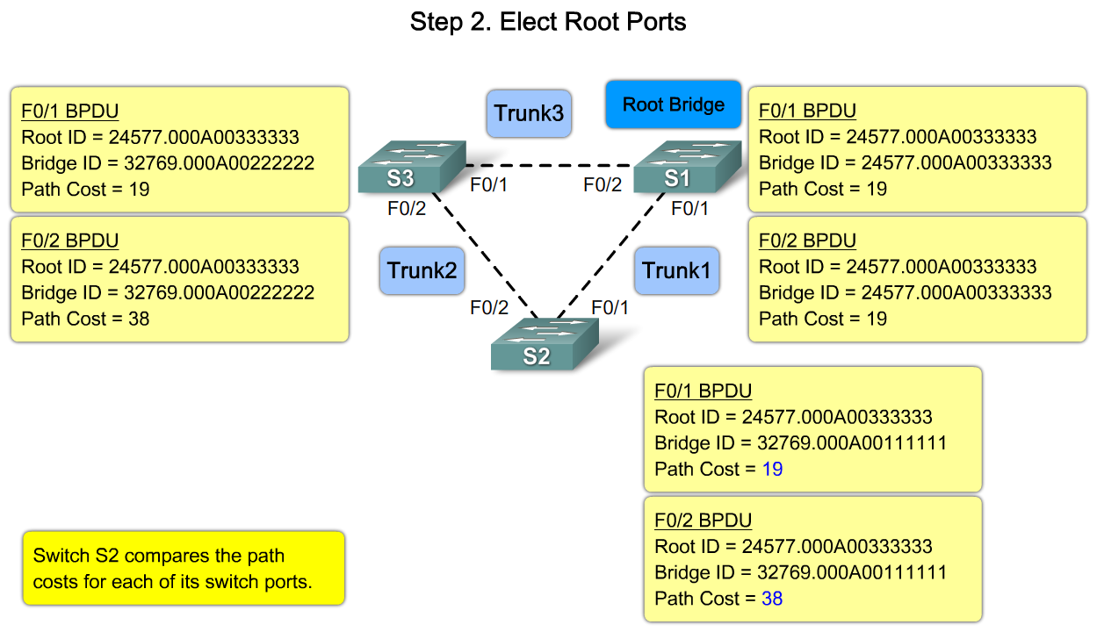
Explain How the STP Algorithm Uses Three Steps to Converge on a Loop-Free Topology
Describe the process of electing a root port on a switch

Slide 14
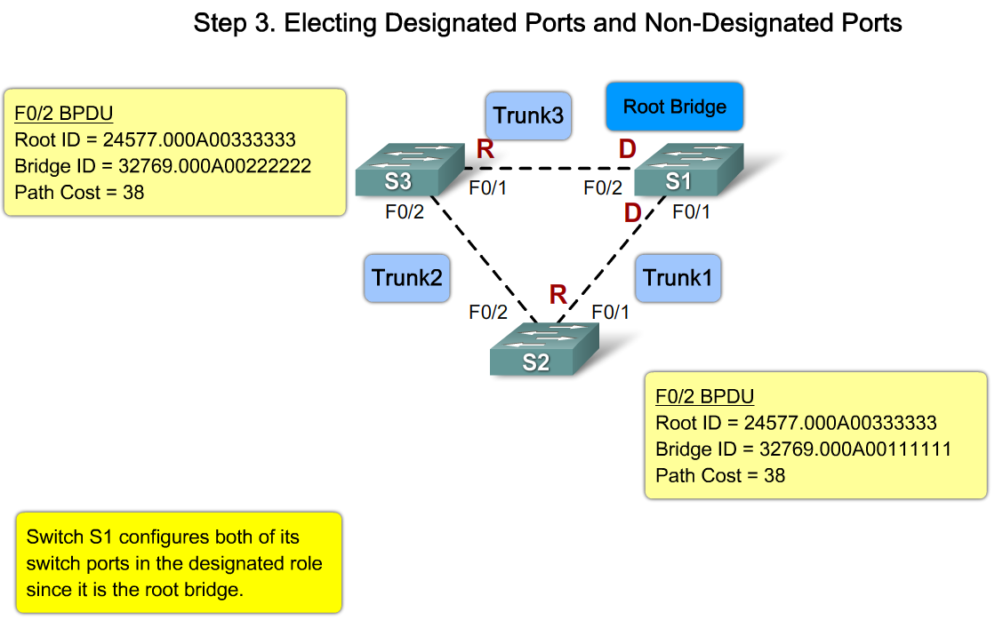
Explain How the STP Algorithm Uses Three Steps to Converge on a Loop-Free Topology
Describe the process of electing designated ports and non-designated ports on a switch

Slide 15
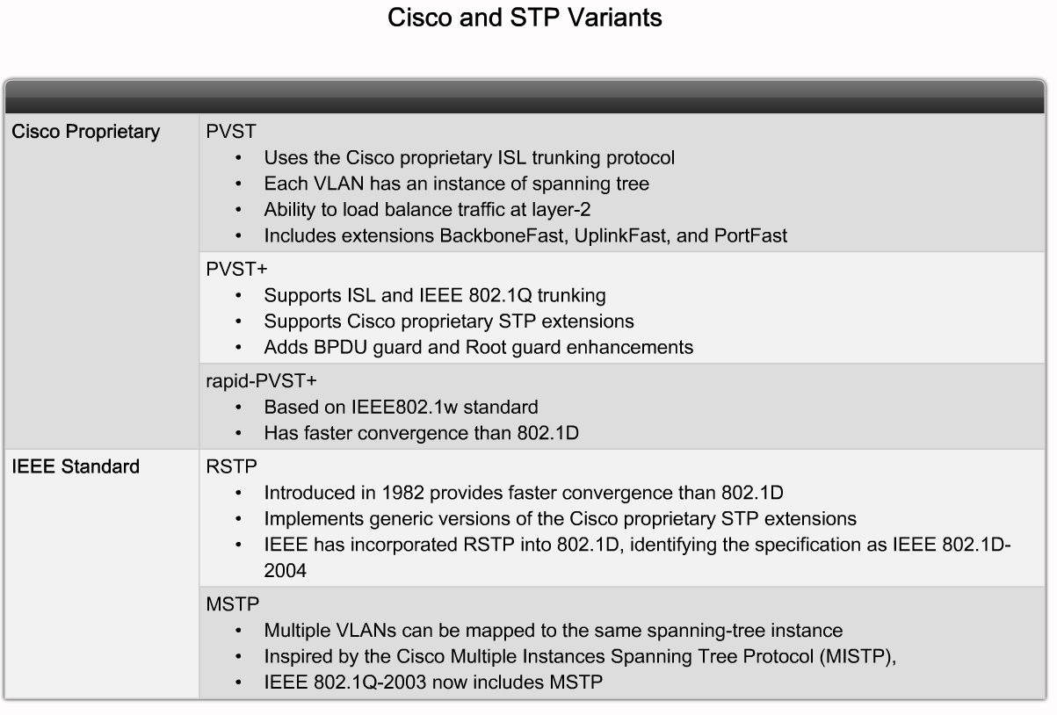
Implement Rapid per VLAN Spanning Tree (rapid PVST+) in a LAN
Summarize the features of the PVST+, RSTP and rapid PVST+ variants of STP

Slide 16
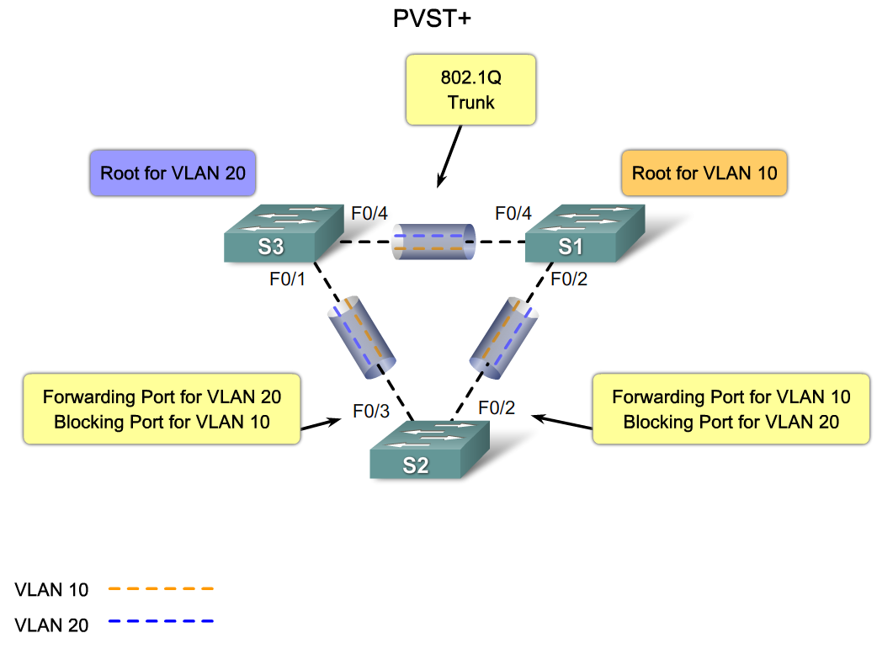
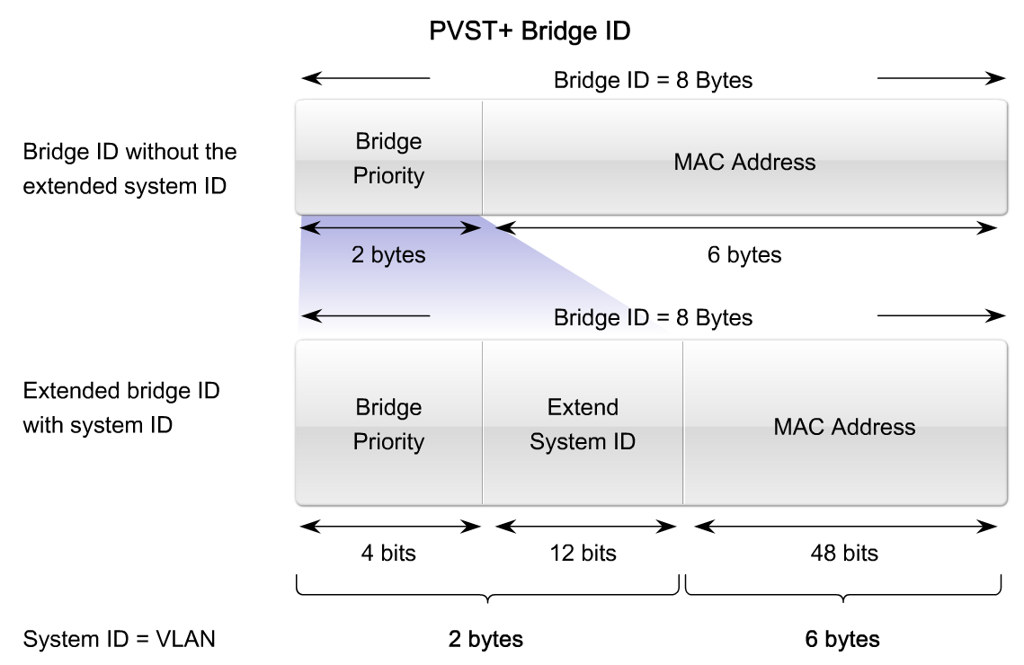
Implement Rapid per VLAN Spanning Tree (rapid PVST+) in a LAN
Describe the features of PVST+

Slide 17
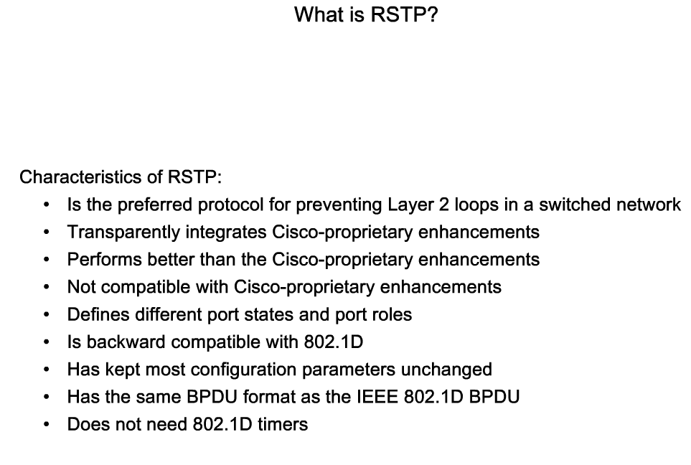
Implement Rapid per VLAN Spanning Tree (rapid PVST+) in a LAN
Describe the features of RSTP

Slide 18
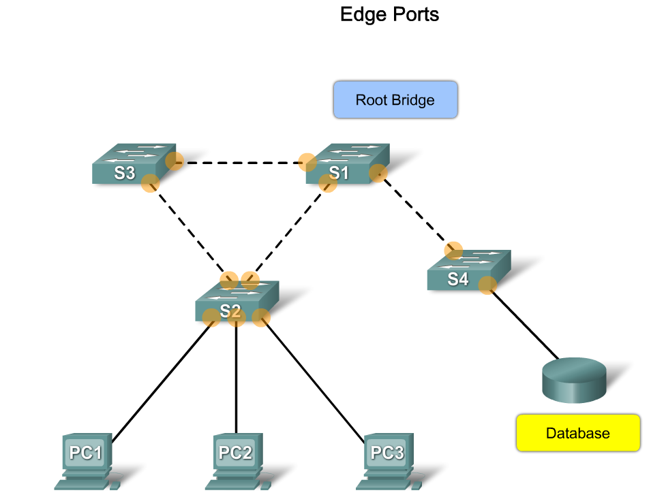
Implement Rapid per VLAN Spanning Tree (rapid PVST+) in a LAN
Describe RSTP edge ports

Slide 19
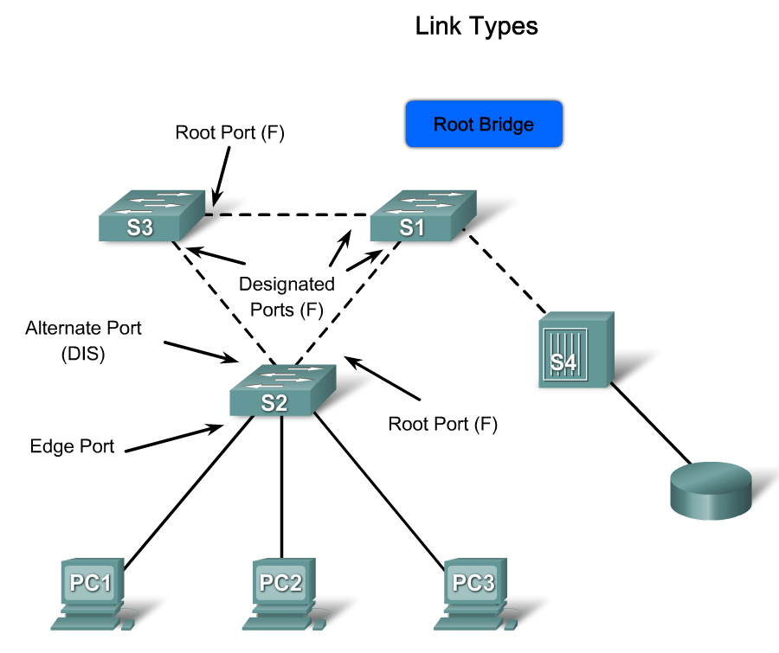
Implement Rapid per VLAN Spanning Tree (rapid PVST+) in a LAN
Describe the RSTP link types

Slide 20
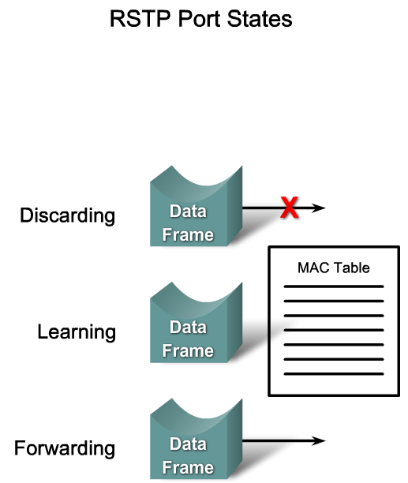
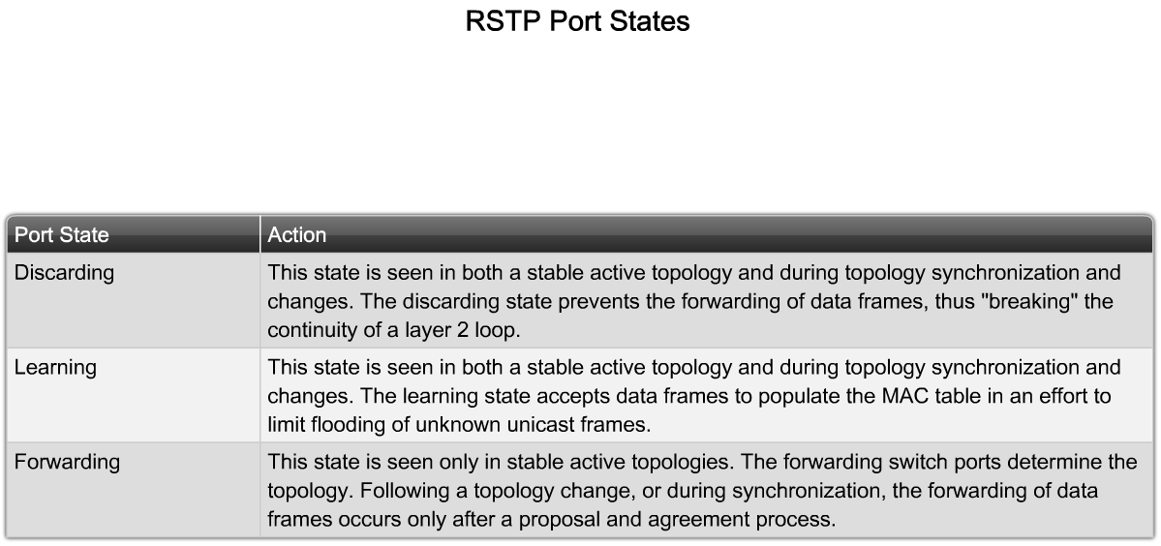
Implement Rapid per VLAN Spanning Tree (rapid PVST+) in a LAN
Describe the RSTP port states and port roles

Slide 21
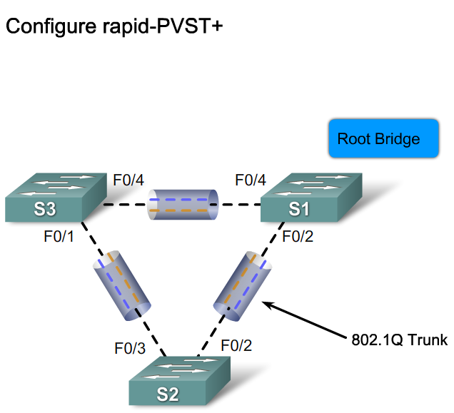
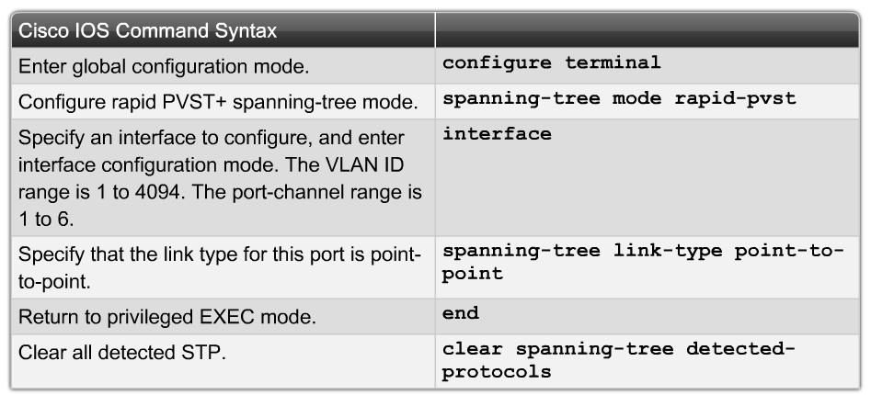
Implement Rapid per VLAN Spanning Tree (rapid PVST+) in a LAN
Describe how to configure rapid PVST+

Slide 22
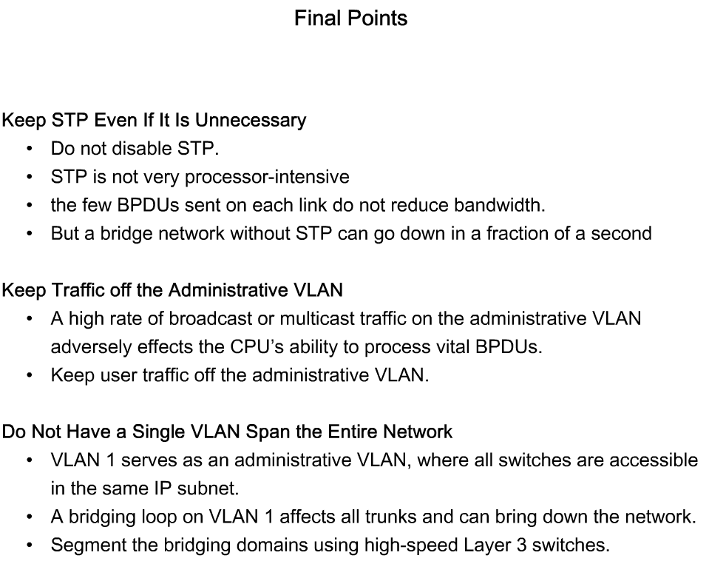
Implement Rapid per VLAN Spanning Tree (rapid PVST+) in a LAN
Describe how to design STP to avoid problems

Slide 23
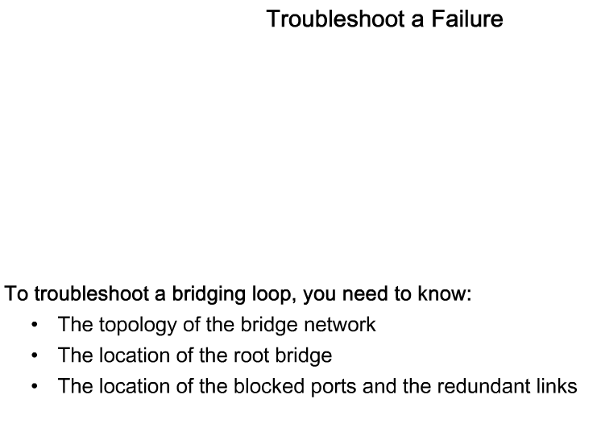
Implement Rapid per VLAN Spanning Tree (rapid PVST+) in a LAN
Describe how to identify and solve the key STP configuration issues

Slide 24
Summary
Spanning Tree Protocol (STP) is used to prevent loops from being formed on redundant networks
STP uses different port states & timers to logically prevent loops
There is at least one switch in a network that serves as the root bridge
  Root bridge is elected using information found in BPDU frames
Root ports are determined by the spanning tree algorithm and are closest to the root bridge

Slide 25
Summary
STP lengthy convergence time (50 seconds) facilitated the development of:
  RSTP
  convergence time is slightly over 6 seconds
  Rapid PVST+
  adds VLAN support to RSTP
  is the preferred spanning-tree protocol on a Cisco switch
  netowrk

